Slide 1
Socket Programming and A2
Yongyong Wei

Slide 2
Outline
Socket Programming
Basic Steps
Example of a simple web server
Demonstration of the 2nd assignment
A Peer-to-Peer file share client
Demo of the effect
Analysis
Skeleton code

Slide 3
Basic Steps

Slide 4
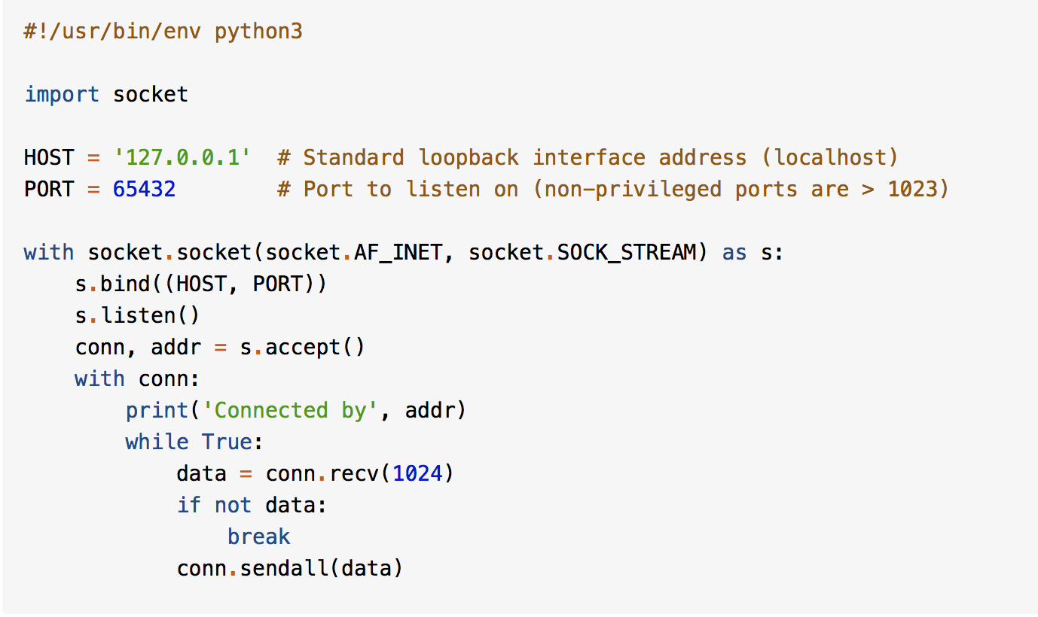
A simple echo server

Slide 5
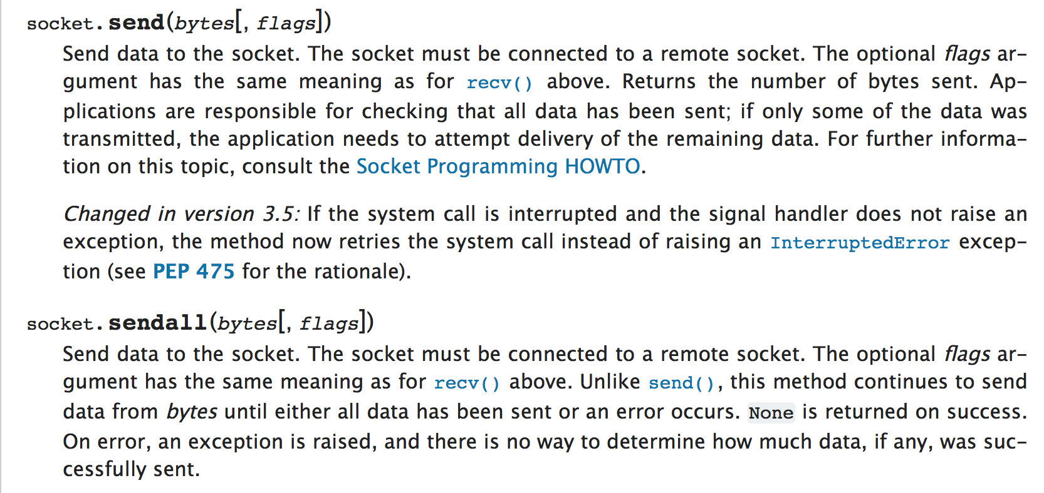
Notes:
More details please refer to API documents
https://docs.python.org/3/library/socket.html

Slide 6
Example of a simple web server
Review of Http Protocol

Slide 7
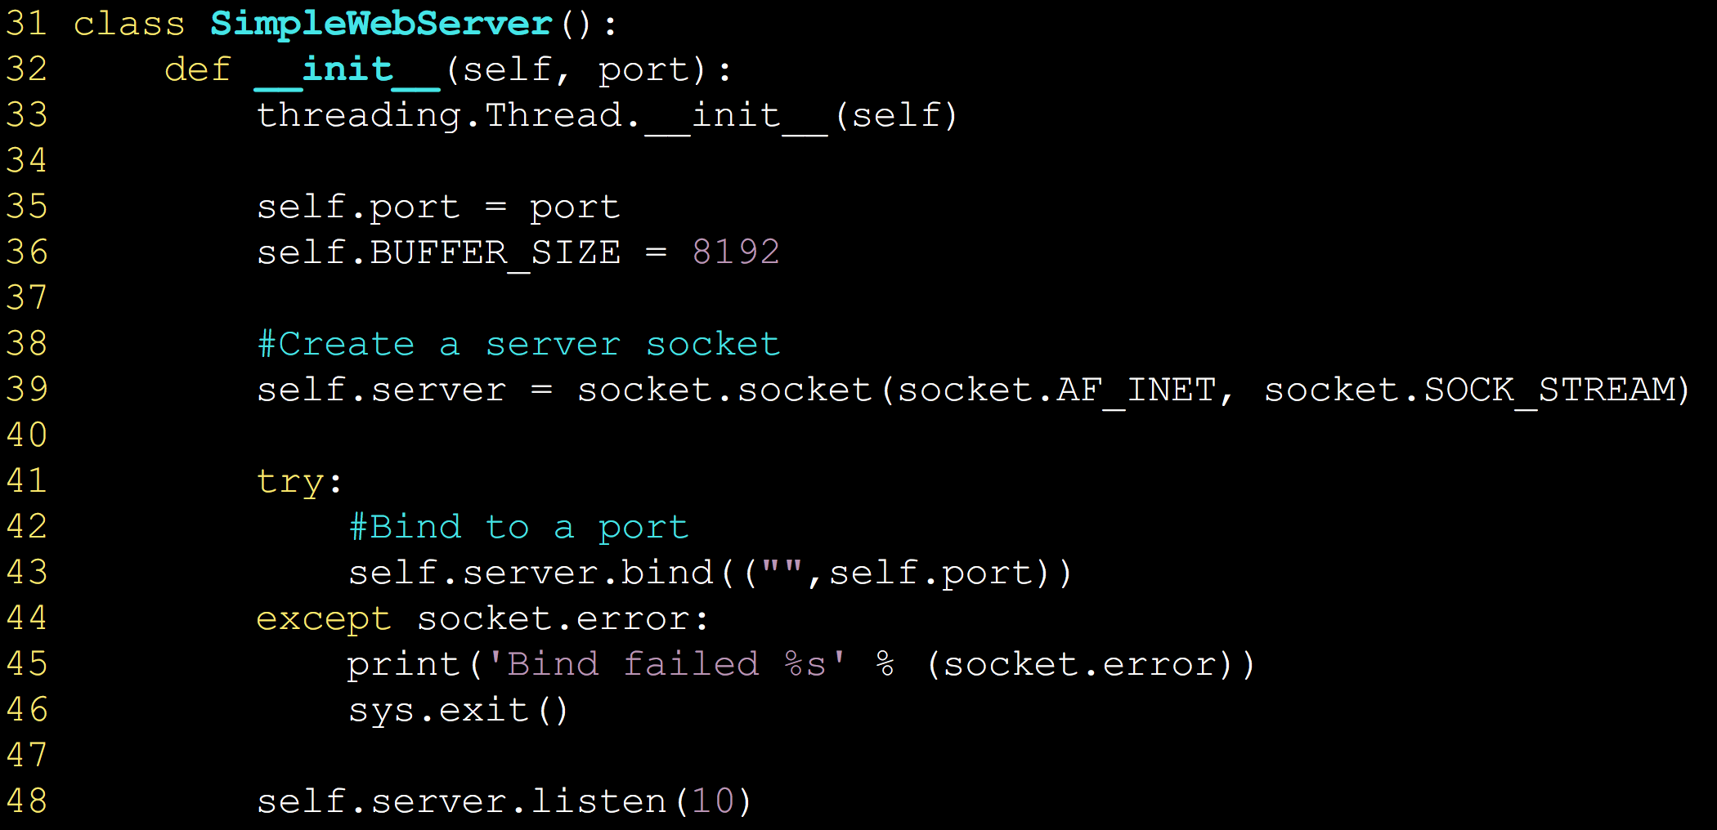
Key code: create socket, bind, listen

Slide 8
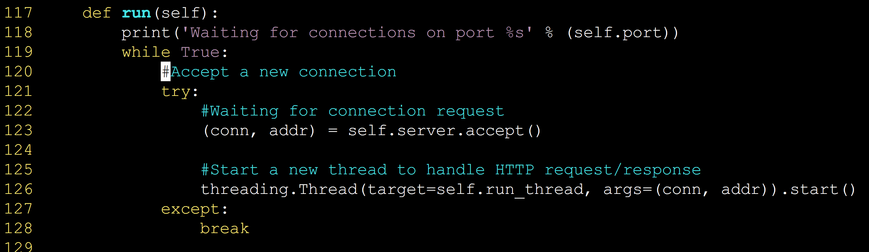
Key code: accept connection

Slide 9
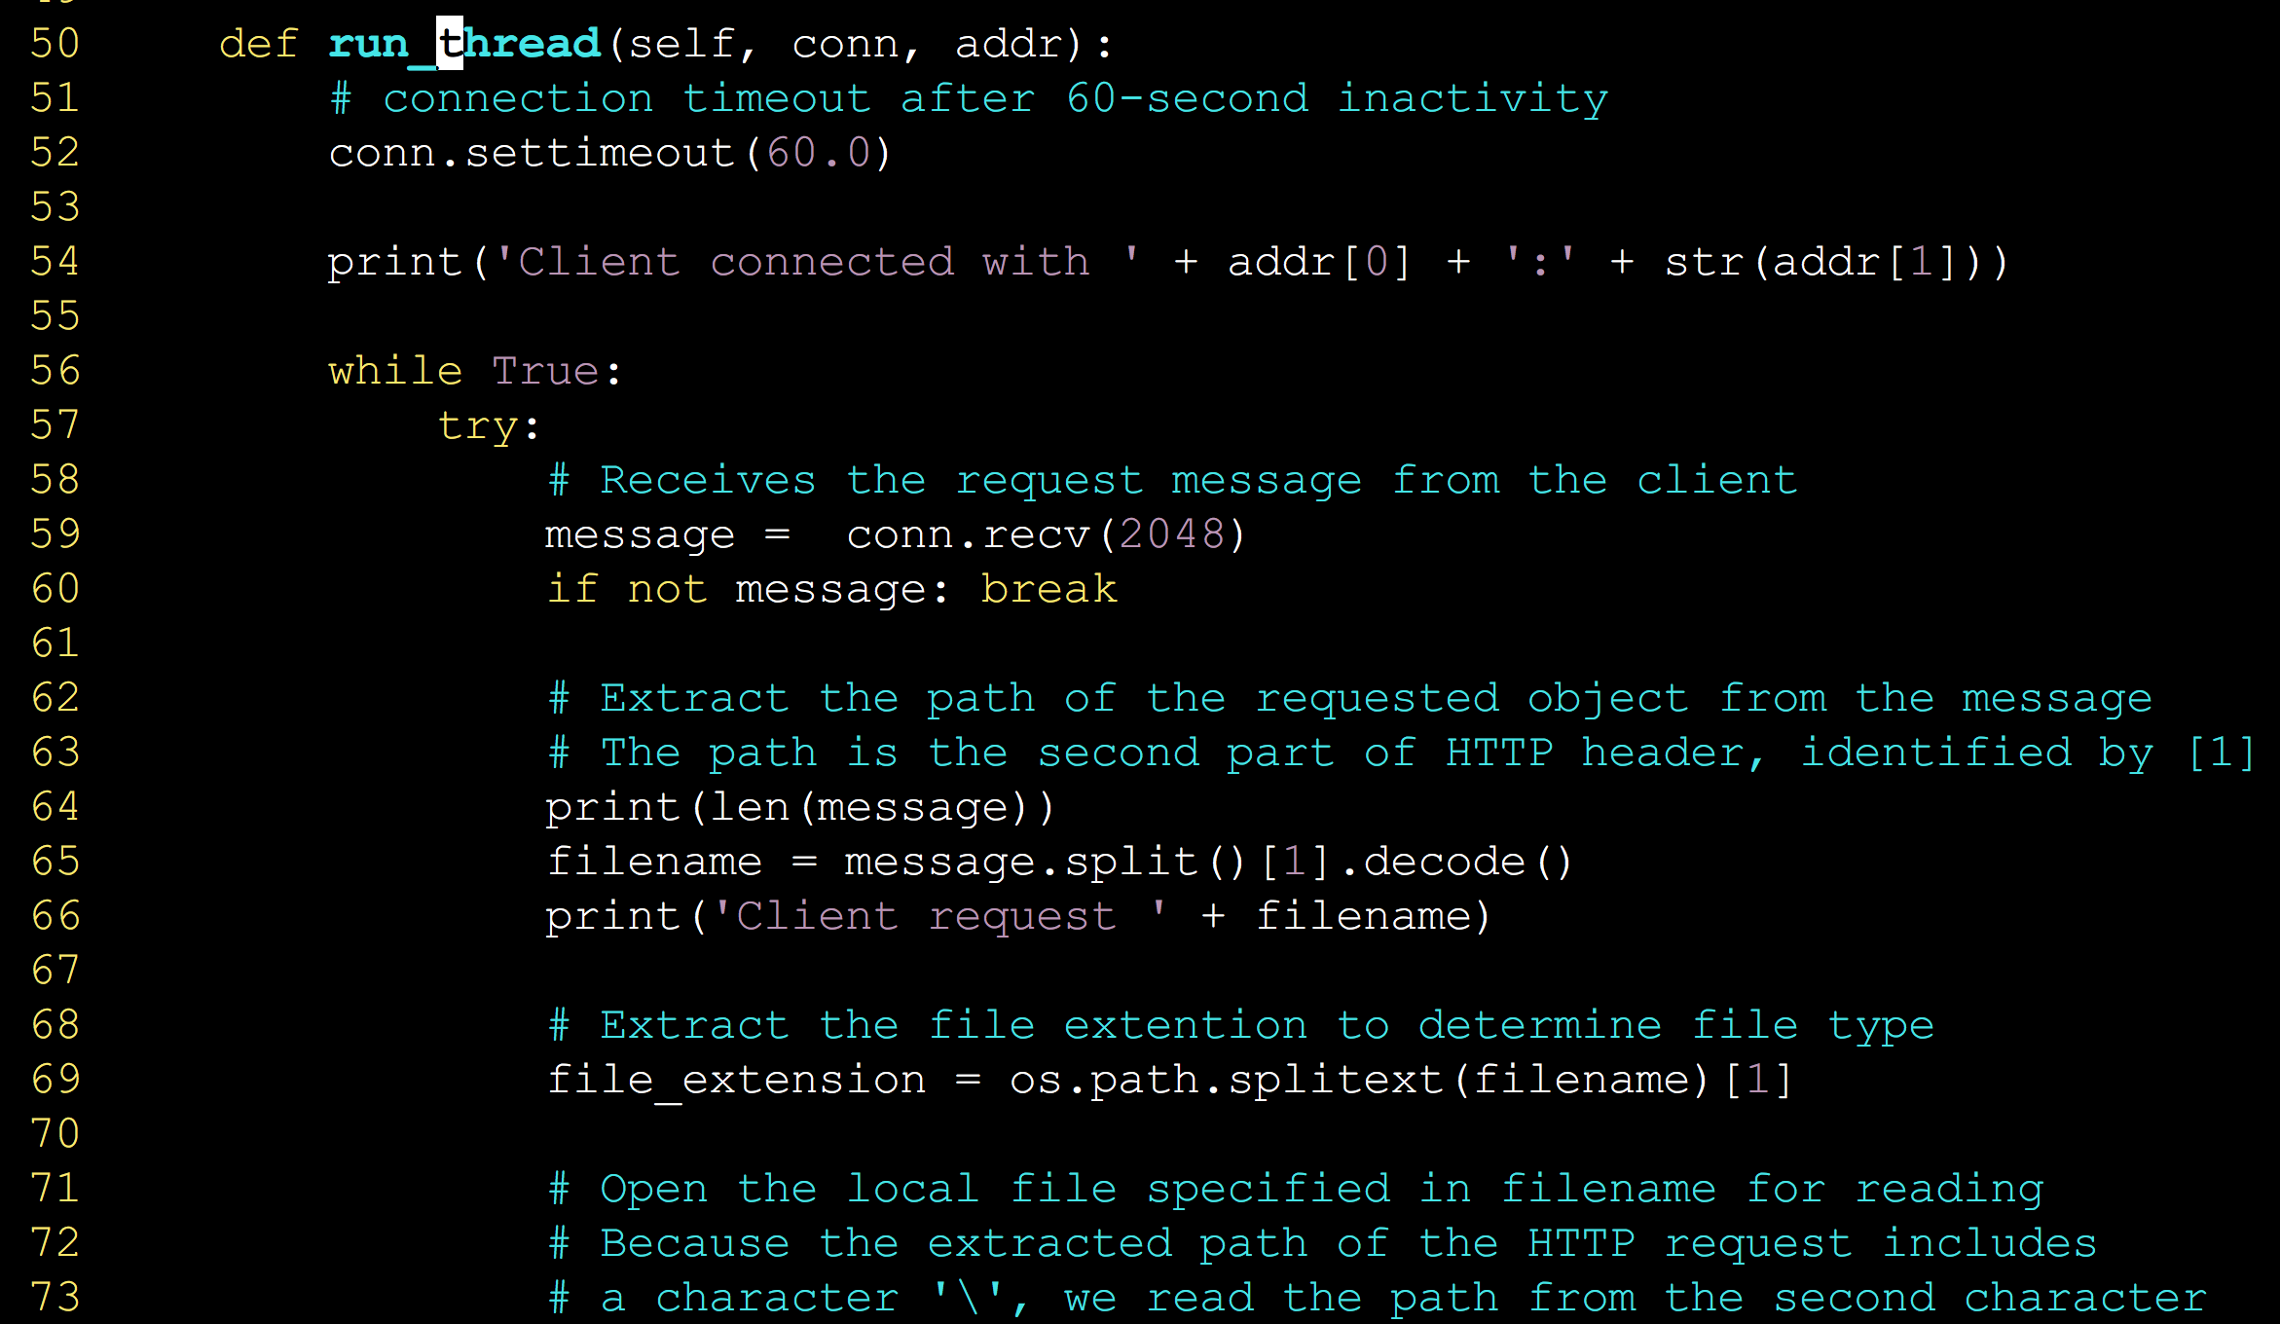
Key code: get the requested file

Slide 10
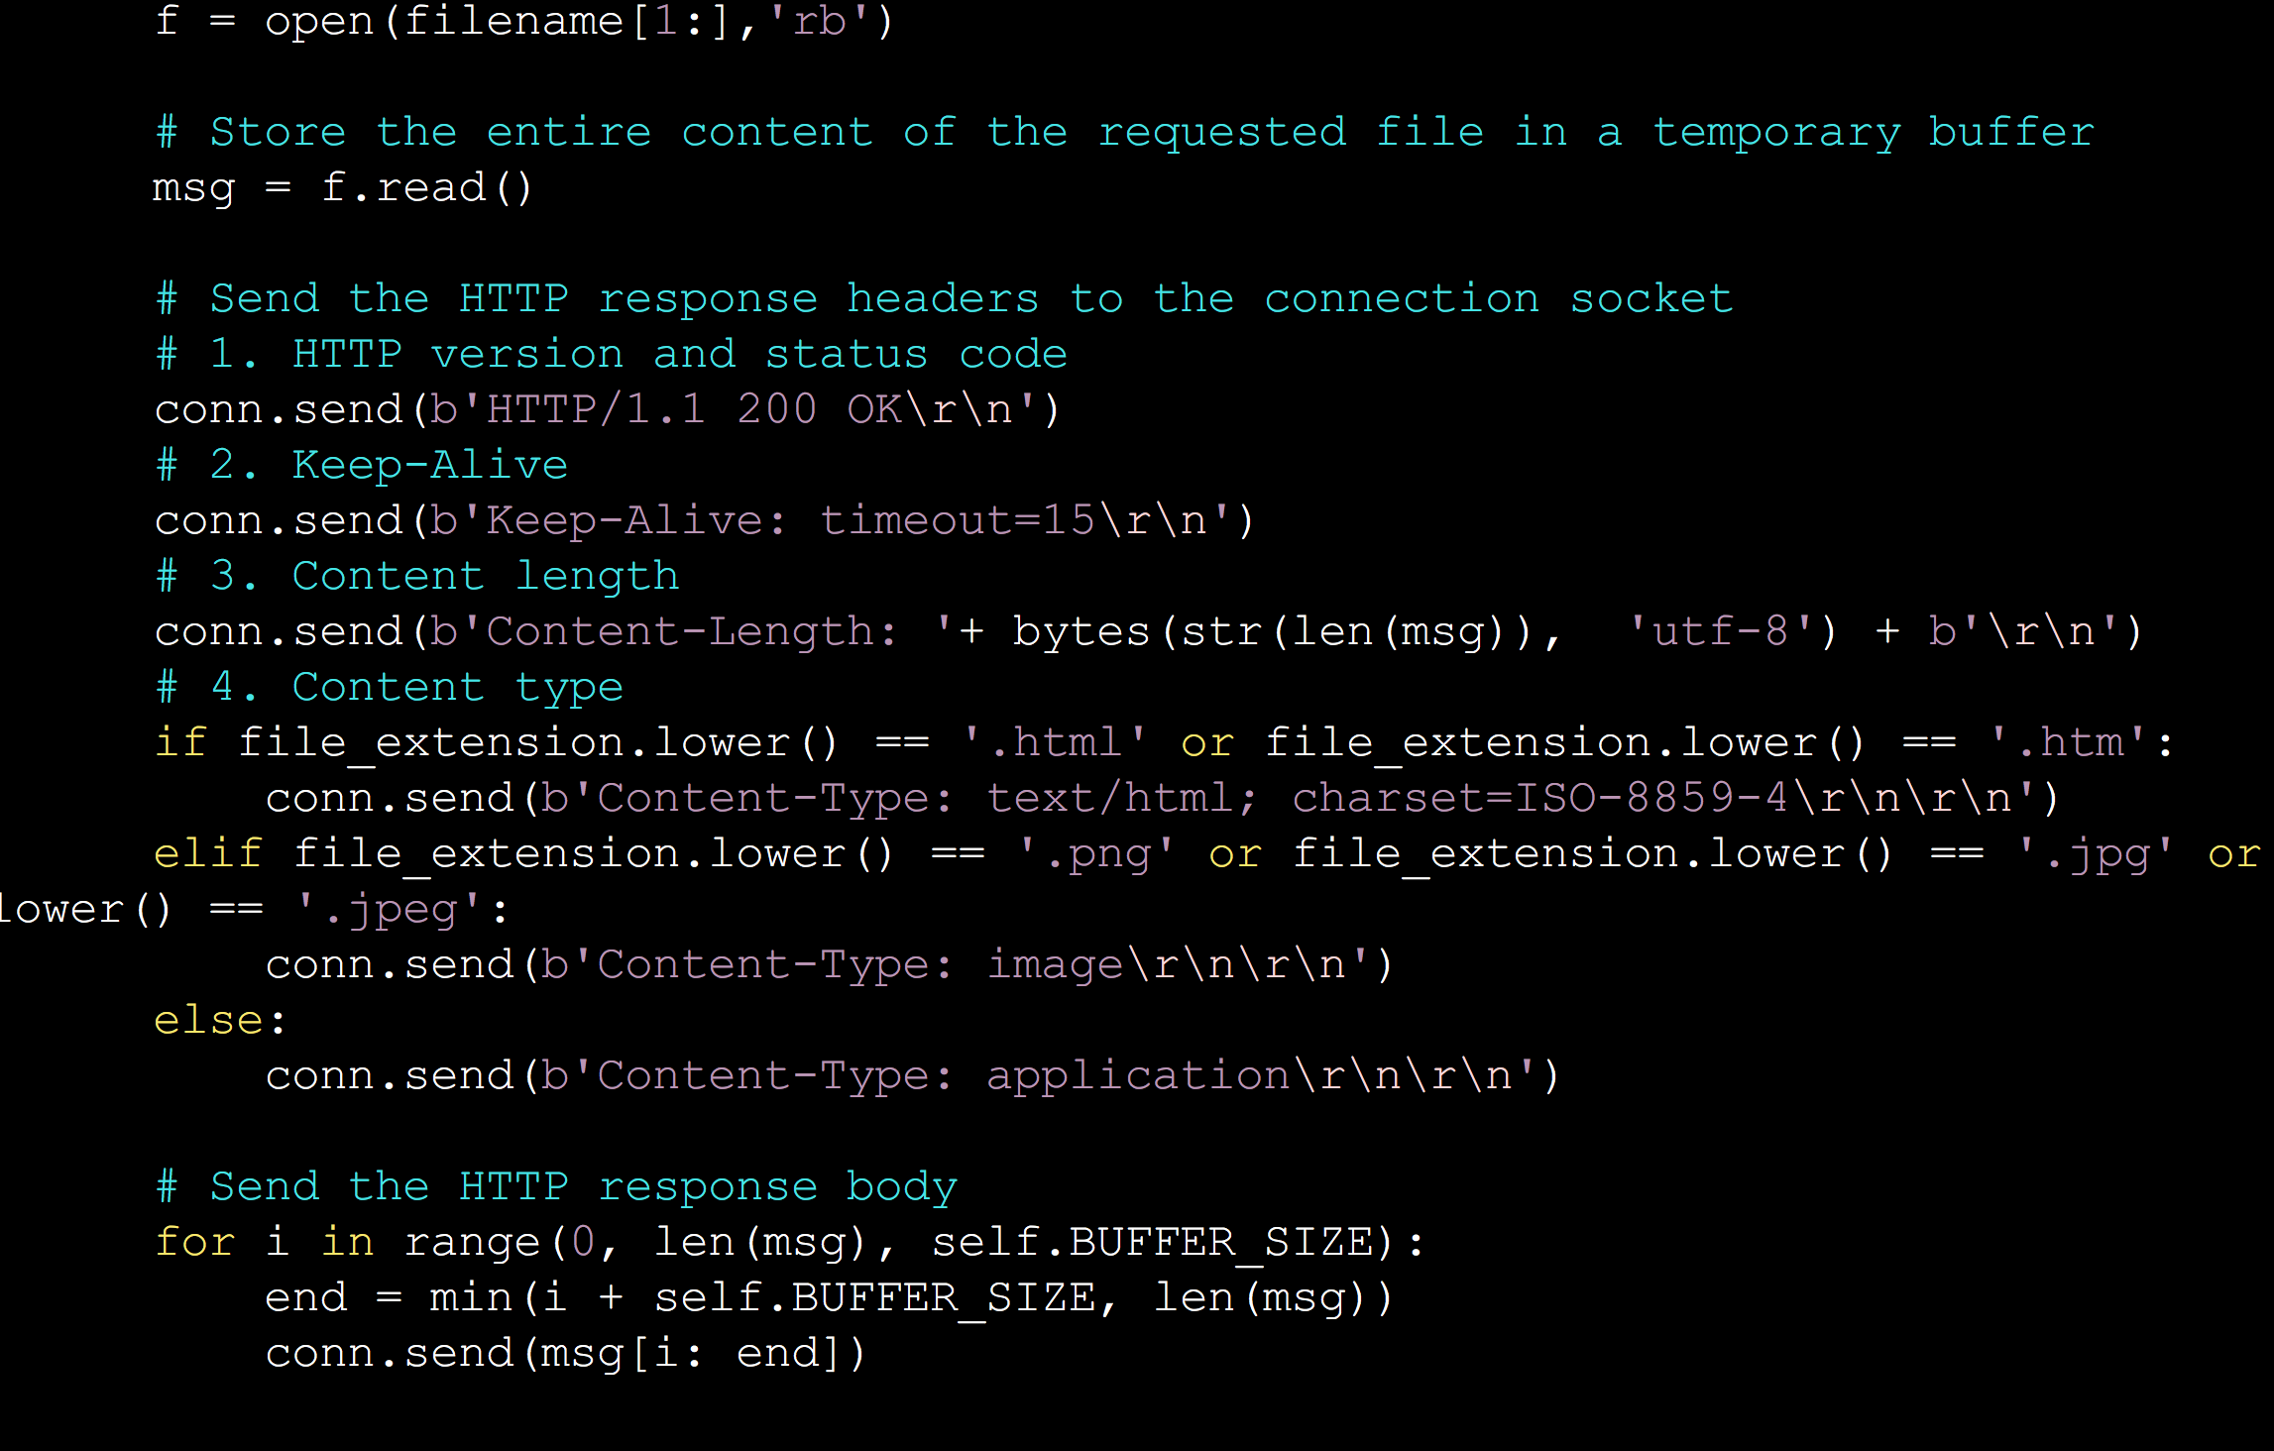
Key code: send back http response

Slide 11
Demonstration of A2: : P2P file sharing

Slide 12
Demo of the effects

Slide 13
Analysis and Tips
Q1. The tracker will store meta data information, which file is stored in which server and port, how the meta data information is obtained?

Slide 14
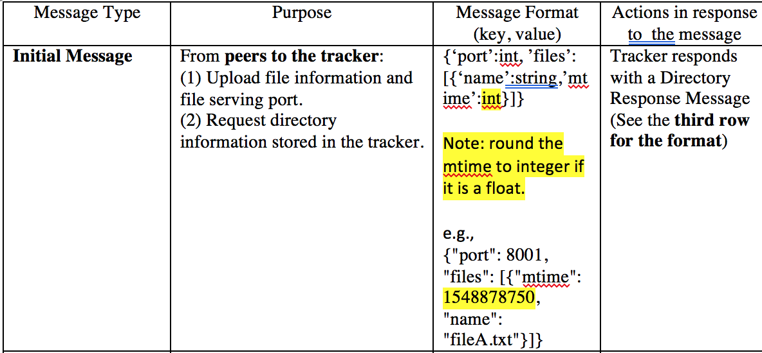
Analysis and Tips
Ans1.
Through messages, which will be sent to the tracker when the client connects to the server.
Message format?

Slide 15
Analysis and Tips
Q2. How a client know which file he is missing and want to synchronize?

Slide 16
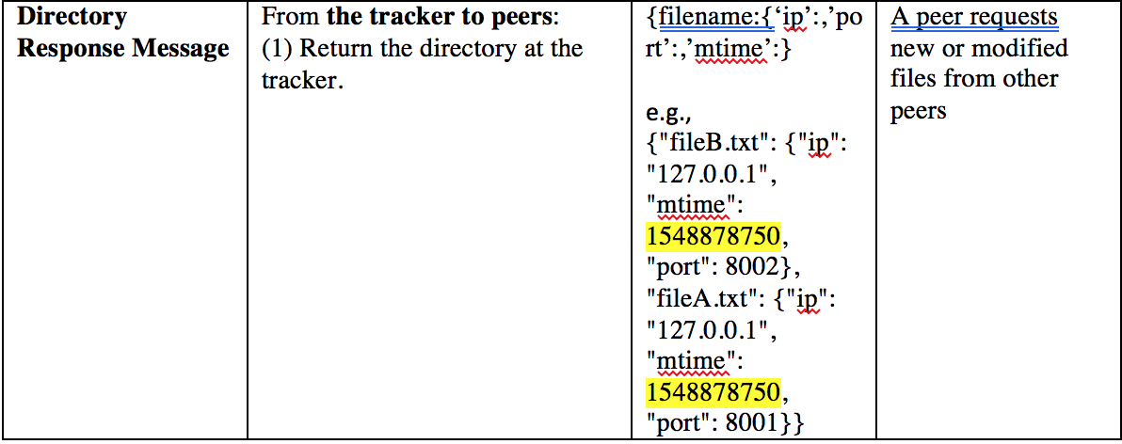
Analysis and Tips
Ans2.
Through messages, which is sent to the client by the tracker.
Message format?

Slide 17
Analysis and Tips
Q3. What if the peer, which has the wanted file, is down?

Slide 18
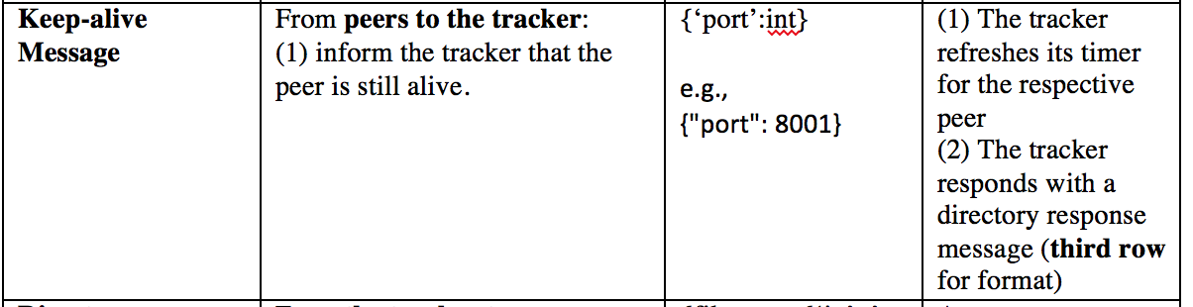
Analysis and Tips
Ans3
Keep alive message
Key word: Timer

Slide 19
Analysis and Tips
Q4. How to request the missing file?

Slide 20
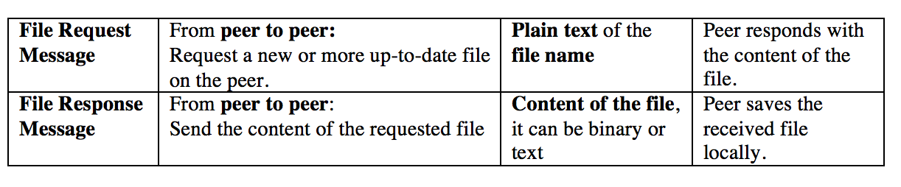
Analysis and Tips
Ans4
This part is similar to the Http server, just respond with the content of the file
The peer need to save the file content with the same name.

Slide 21
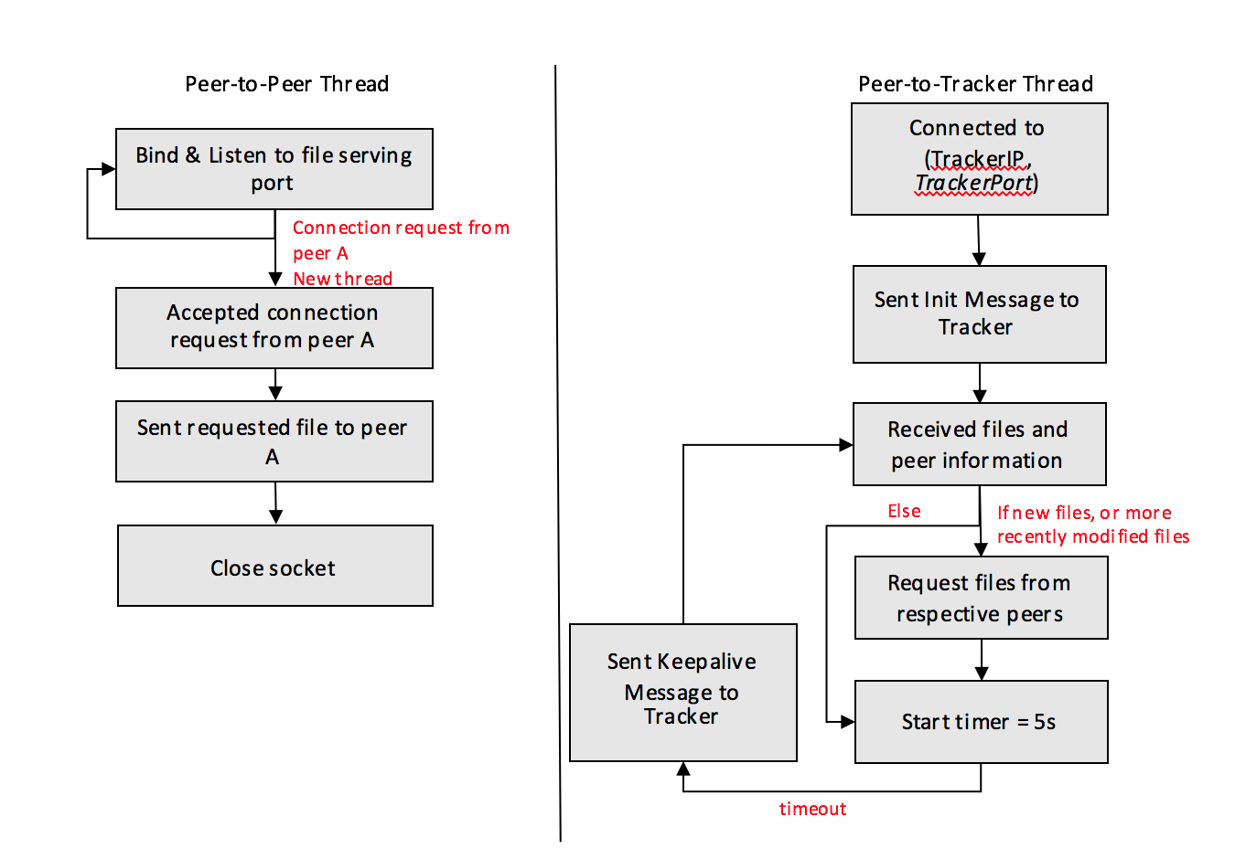
Summary

Slide 22
Skeleton code

Slide 23
Submission of A2
Very important:
Please follow the specifications in instructions.pdf, especially, the file name of submission must be followed strictly, otherwise it may not be graded.

